Slide 1
Health Psychology for Nursing
University of Basra
College of Nursing
Assisst.Lec. Doaa M. Bachi

Slide 2
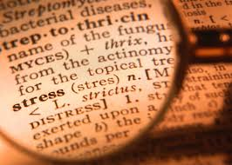
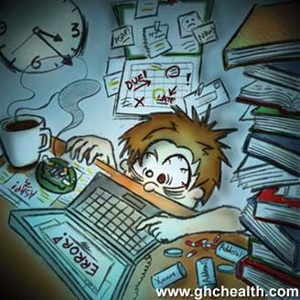
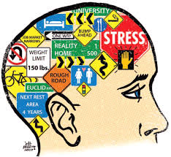
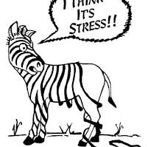
In your own words, write down a definition of “stress.”
Let’s define it!

Slide 3
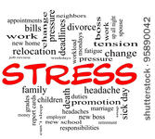
a state of mental tension and worry caused by problems in your life, work, etc” “something that causes strong feelings of worry or anxiety

Slide 4
Identifying Stressors
The sources or stimuli for stress are called stressors.
Stressor is the stimuli proceeding or precipitating a change. It may be internal (fear, guilt) or external (trauma, peer pressure, etc)
Situations, activities, and relationships that cause ‘trauma’ to one’s physical, emotional, or psychological self

Slide 5
Types of stressors
1. Physiological stressors
a. Chemical agents
b. Physical agents Illness, injuries, hormonal fluctuations, inadequate sleep or nutrition
c. Infectious agent
d. Nutrition imbalances
e. Genetic or immune disorders

Slide 6
2. Psychological Stressors
Accidents can cause stress for the victim, the person who caused the accident and the families of both•
Stressful experiences of family members and friends•
Fear of aggression or mutilation from others such as murder, rape, terrorist and attacks.

Slide 7
Events that we see on T.V. such as war, earthquake, violence•
Developmental and life events•
Rapid changes in our world, including economic and political structures and technology

Slide 8
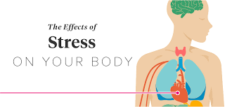
Your central nervous system (CNS) is in charge of your “fight or flight” response. In your brain, the hypothalamus gets the ball rolling, telling your adrenal glands to release the stress hormones adrenaline and cortisol. These hormones rev up your heartbeat and send blood rushing to the areas that need it most in an emergency, such as your muscles, heart, and other important organs.
When the perceived fear is gone, the hypothalamus should tell all systems to go back to normal. If the CNS fails to return to normal, or if the stressor doesn’t go away, the response will continue.

Slide 9
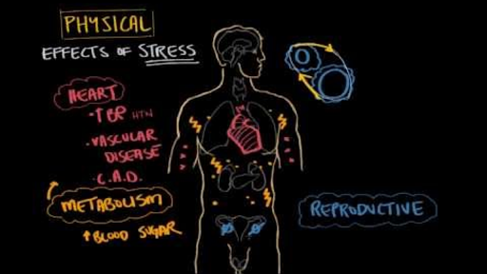

Slide 10
Types of Stress
1. Eustress
The optimal amount of stress, whichhelps to promote health and growth.e.g.: praise from a superior for hardworking.
2. Distress
Stress due to an excess of adaptive demands placed upon us. The demands are so great that they lead to bodily and mental damage. e.g.: unexpected death of a loved one.

Slide 11
3. Acute stress
It’s our body's immediate reaction to a new challenge, event, or demand, and it triggers your fight- or-flight responses. Example: pressures of a near-miss automobile accident or arguments with family
4. Episodic acute stress
When acute stress happens frequently, it’s called episodic acute stress. They commonly have a negative outlook or worry about everything. They think of stress as part of their lives and have difficulties changing their lifestyles
5. Chronic stress
If acute stress isn't resolved and begins to increase or lasts for long periods of time, it becomes chronic stress. This stress is constant and doesn’t go away.

Slide 12
Sources of Stress
1. Internal Stressors
they originate within a person e.g.: cancer, feeling of depression
2. External stressors
it originates outside the individual e.g.: moving to another city, death in a family.

Slide 13
3. Developmental stressors
it occurs at predictable times throughout an individual‘s life. e.g.: child- beginning of school.
4. Situational stressors
they are unpredictable and occur at any time during life. It may be positive or negative. e.g.: death of family member, marriage/ divorce.

Slide 14
Signs of Stress
Physical, Emotional & Behavioral
Racing Heart
Shaky Hands/Legs
High Blood Pressure
Headaches
Tenseness
Muscle Spasms
Indigestion
PHYSICAL

Slide 15
Signs of Stress
Physical, Emotional & Behavioral
Anxiety
Fear
Irritability
Impatience
Depression
Inability to Focus
Guilt
EMOTIONAL

Slide 16
Signs of Stress
Physical, Emotional & Behavioral
Change in Appetite
Difficulty Sleeping
Forgetfulness
Social Withdrawal/Avoidance
Increased use of Caffeine and Other Substances
Loss of Concentration
Mood Swings
BEHAVIORAL

Slide 17
Can stress be positive?
Stress can motivate you to meet your goals.
The stress of a deadline can motivate you to finish the assignment.
A fire alarm can cause stress that alerts you to avoid danger.
Planning a vacation.
Getting promoted at work.

Slide 18
Coping Strategies
Be realistic: Set limits. Say no to extra responsibility or activities if feeling overwhelmed.
Stop being a superhero: No one is perfect so don't expect that from yourself or others.
Take one thing at a time: When feeling overwhelmed by many tasks, pick one urgent task. Complete one task before moving onto another.
Share feelings: Stay in touch with people! Friends can provide a sounding board, show support and provide guidance.

Slide 19
Ways to Manage Stress
Exercise
Eat Healthy
Practicing Positive Self-Talk
Limit Negative People in Your Life
Time Management
Get Enough Sleep
Meditation
Art Therapy (Sketching, Journaling, Coloring, etc)
Ask for help.
Breathing Exercise.

